Slide 1


Slide 2
Information Security Awareness
Here is where your presentation begins

Slide 3
Why We Need This
Understanding the overall impact of a cyberattack will inspire everyone to be more vested in mitigating vulnerabilities

Slide 4
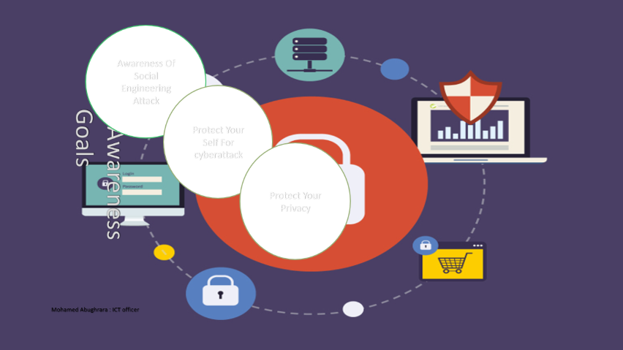

Slide 5
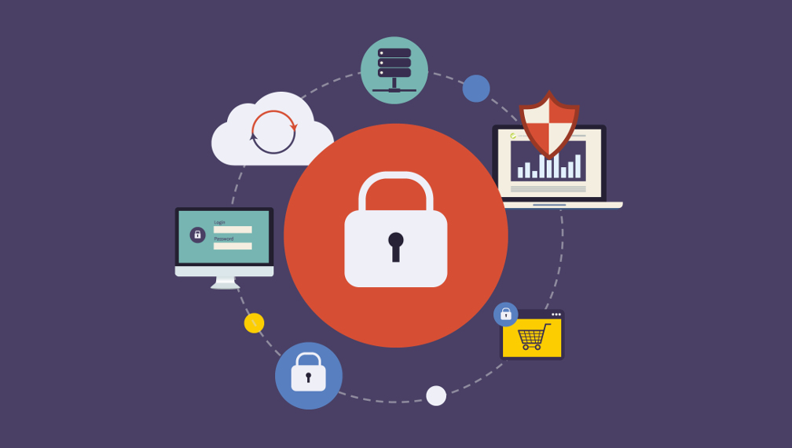
Security Awareness Goals
Awareness Of Social Engineering Attack
Protect Your Self For cyberattack
Protect Your Privacy

Slide 6
What is Information Security
Information Security is not only about technology, but about how it is used and how to implement daily practices which improve both organizational and personal security

Slide 7
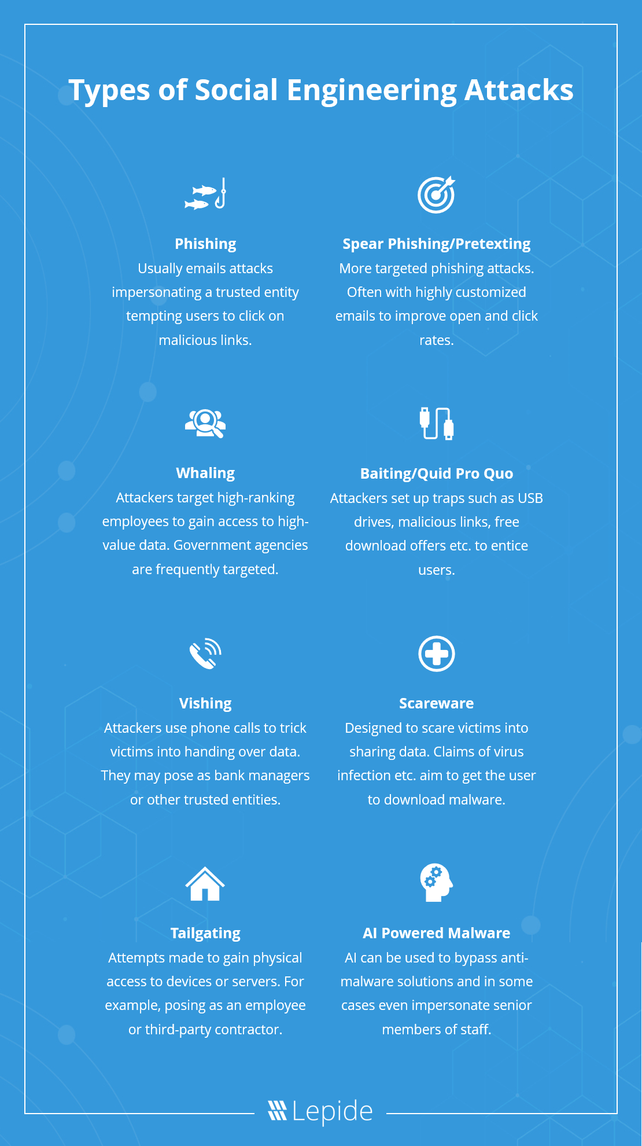

Slide 8
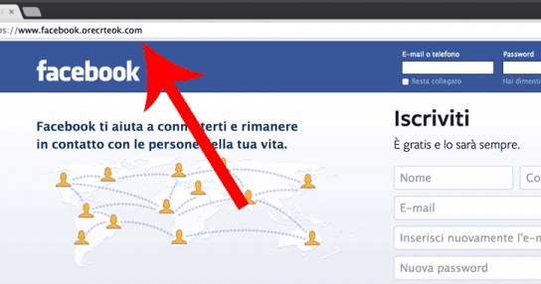
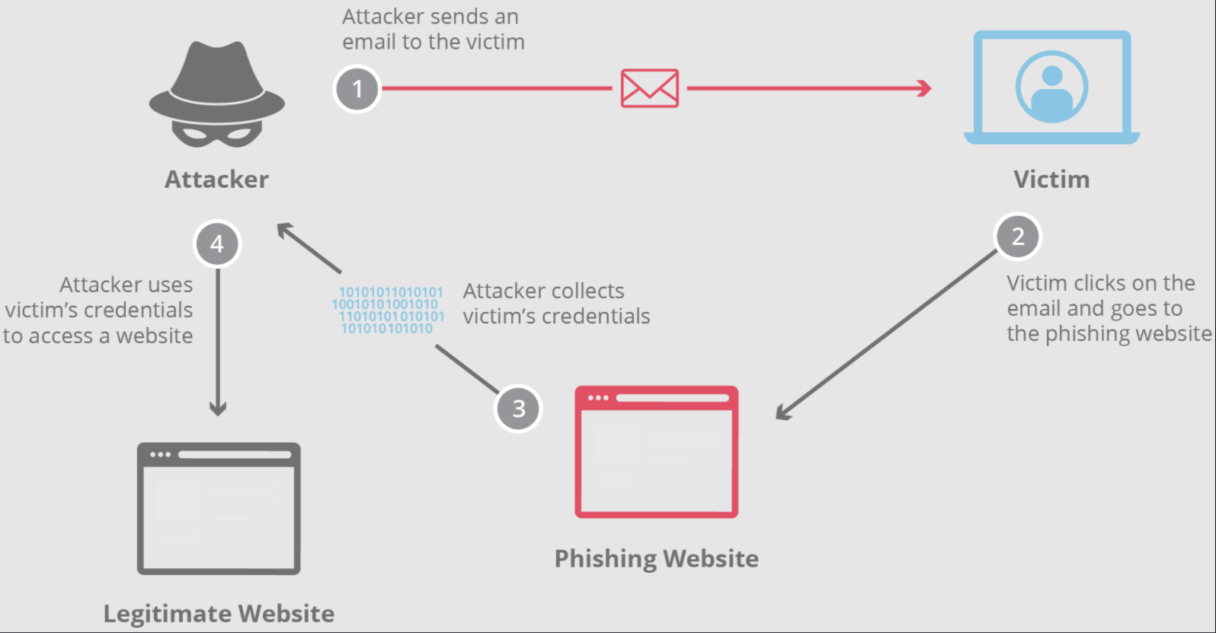
Types of Social Engineering Attacks
Phishing
Usually emails attacks impersonating a trusted entity tempting user to click on malicious links

Slide 9
Types of Social Engineering Attacks
Here’s a summary of what we found:
Brand | Total Fake Login Pages | Percent of All Fake Login Pages
PayPal | 11,000 | 22%
Microsoft | 9,500 | 19%
Facebook | 7.500 | 15%
eBay | 3,000 | 6%
Amazon | 1,500 | 3%
More than 50,000 fake login pages were identified
More than 200 of the world’s most prominent brands were spoofed with fake login pages
Nearly 5% (2,500) of the 50,000 fake login pages were polymorphic, with one brand garnering more than 300 permutations
The most common recipients of fake login page emails work in the financial services, healthcare and technology industries as well as at government agencies
The top 5 brands with the most fake login pages closely mirrors the list of brands that frequently have the most active phishing websites

Slide 10
Types of Social Engineering Attacks
Baiting
Baiting is Phishing’s devious cousin. As the name suggests, Baiting involves luring an unsuspecting victim with a highly attractive offer playing on fear, greed and temptation to make them part with their personal sensitive data like log-in details.

Slide 11
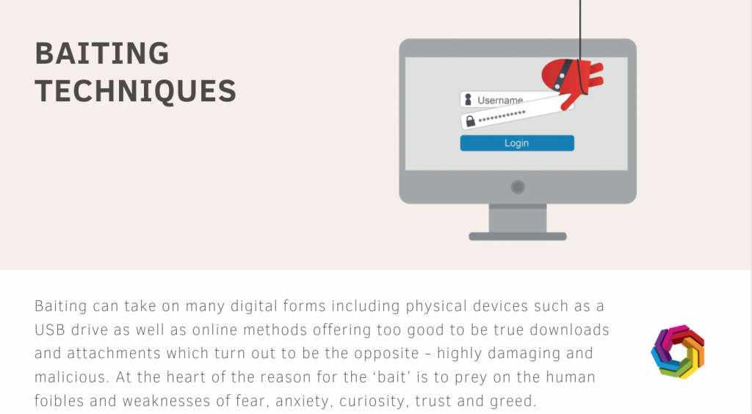
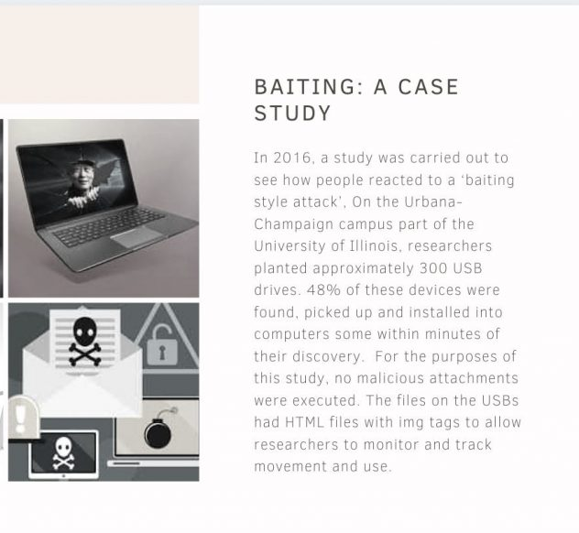
Why we need

Slide 12
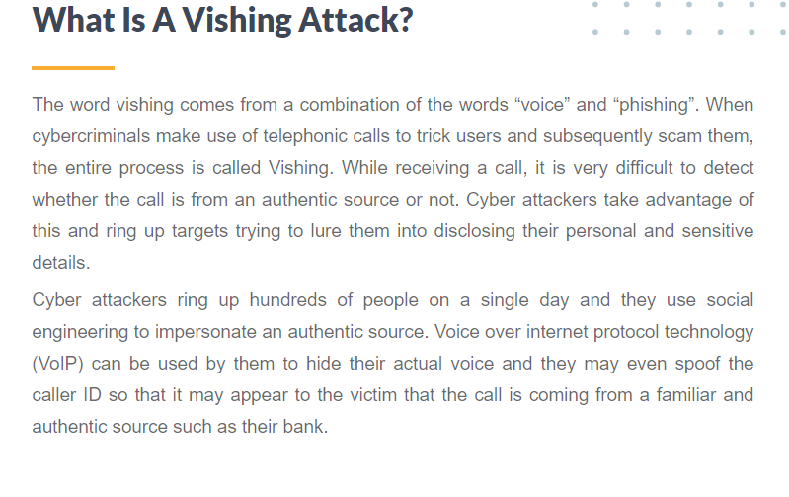
challange

Slide 13
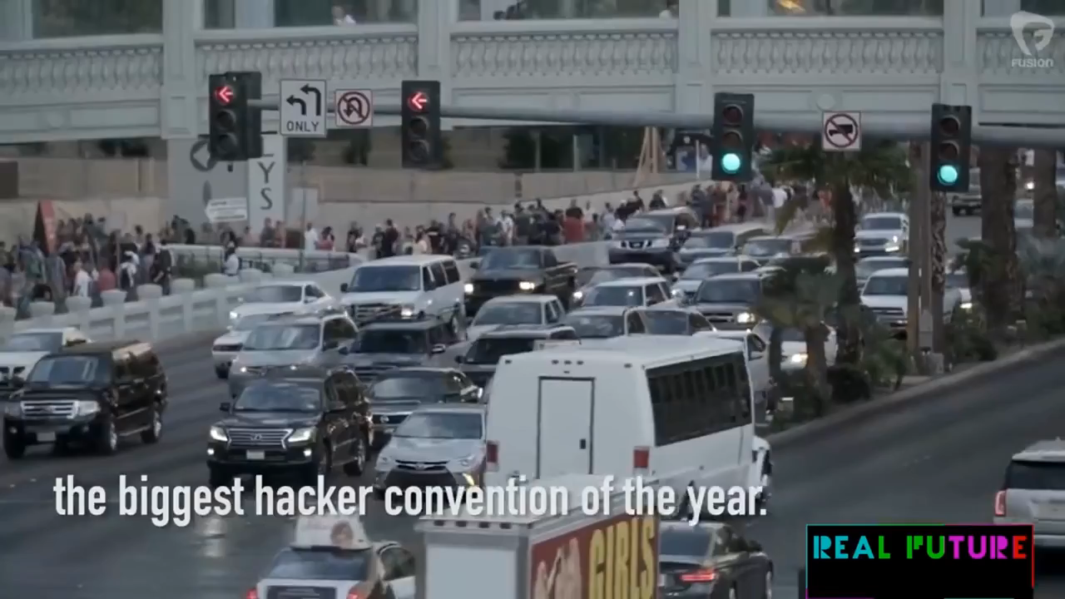
challange

Slide 14
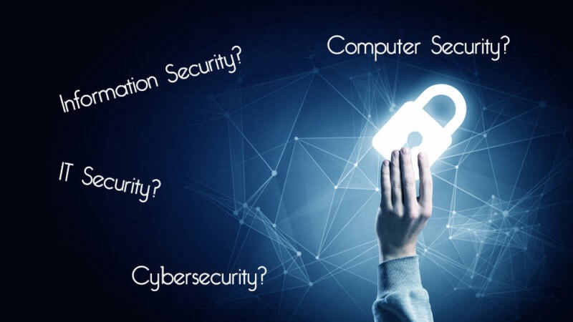
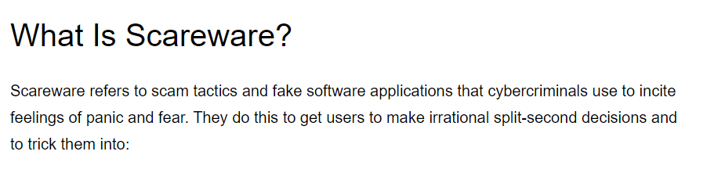
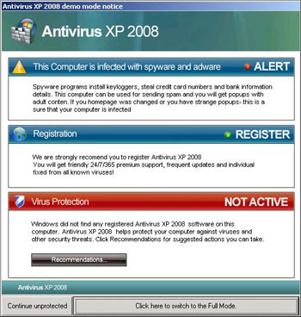
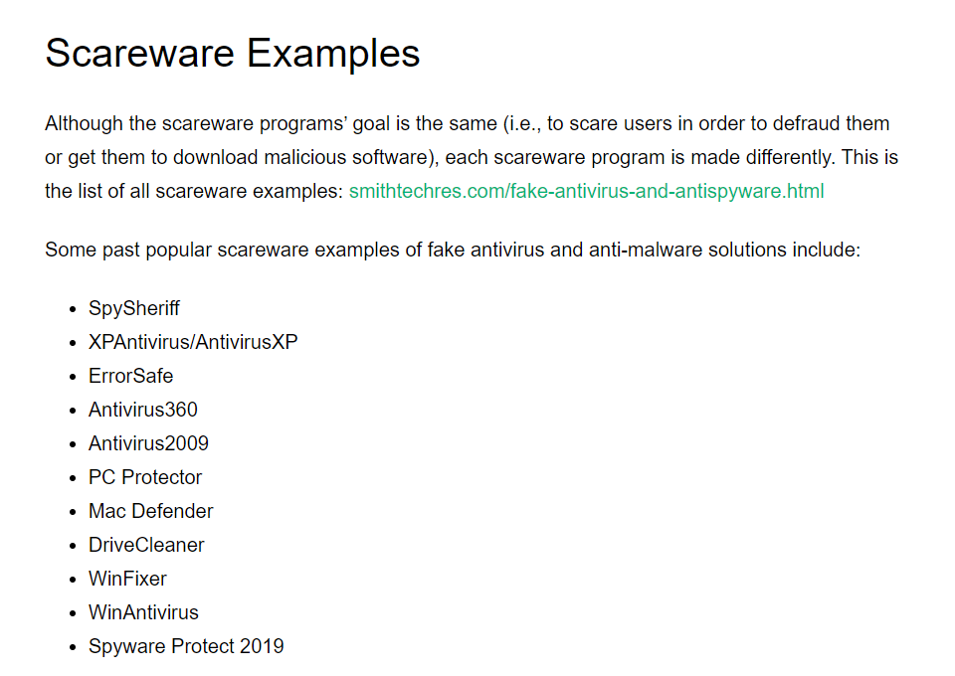
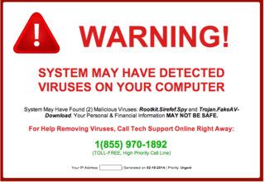

Slide 15
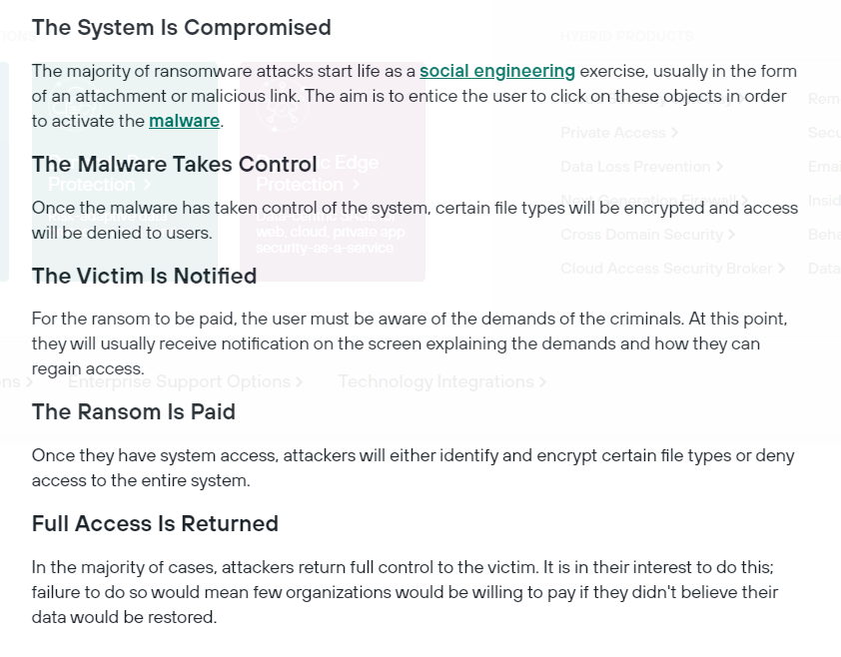
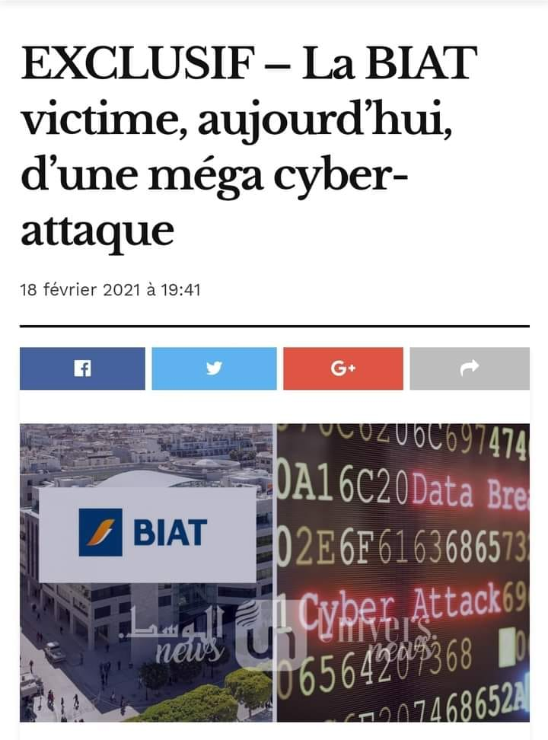

Slide 16
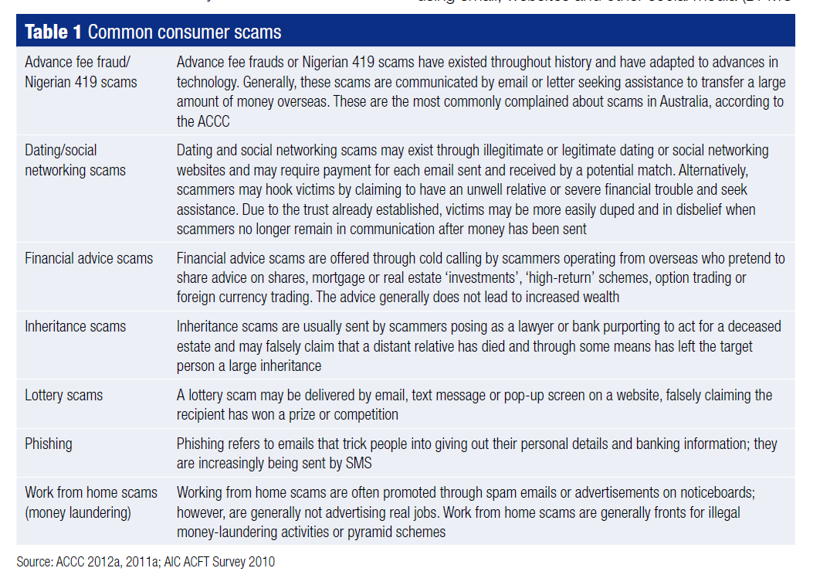
Most Poplar Scams Type

Slide 17
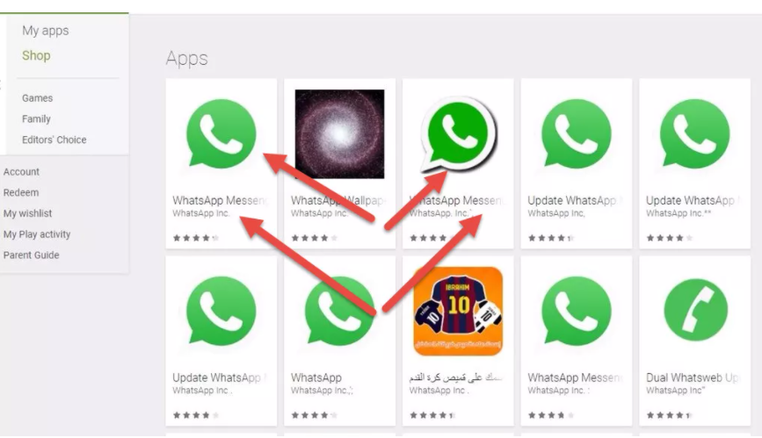

Slide 18
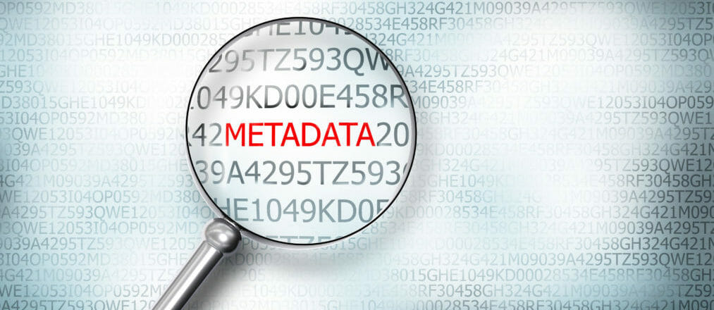

Slide 19
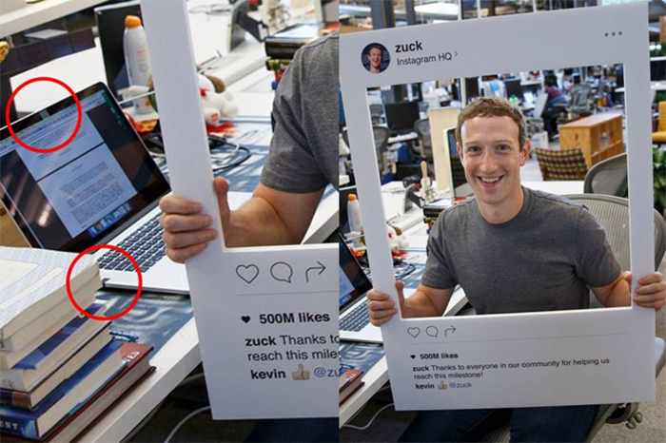

Slide 20
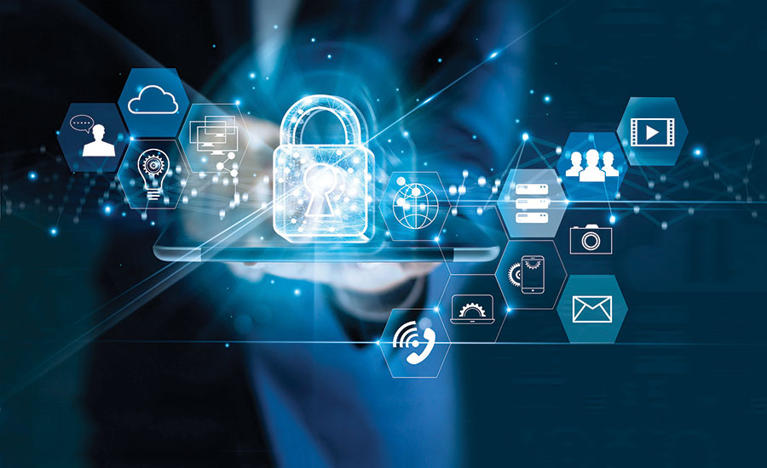


Slide 21
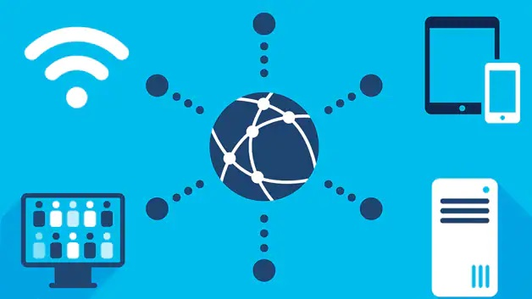
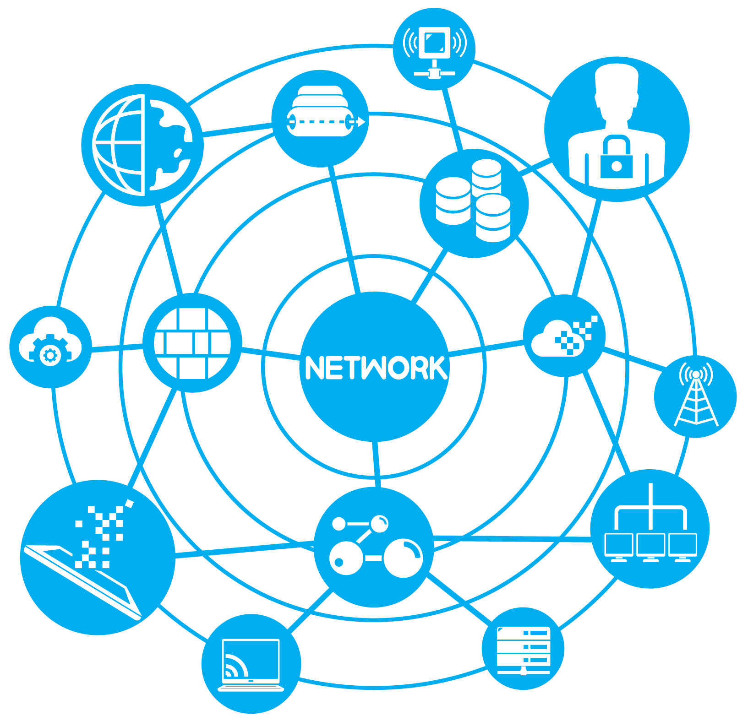

Connecting to network
SAFE :
Mobile Data
Trusted VPN
Not Sharing over public network
We done access to personal data over public network

Slide 22
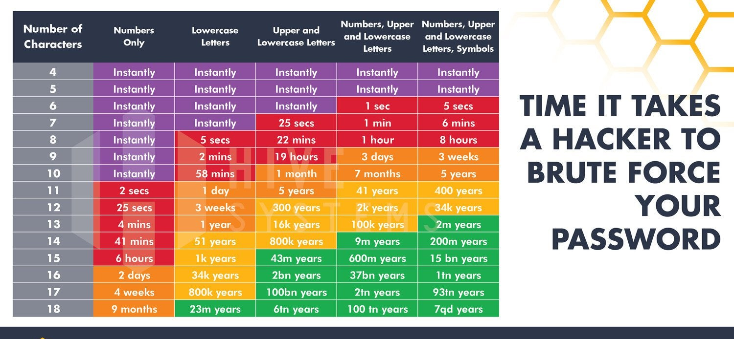

Slide 23
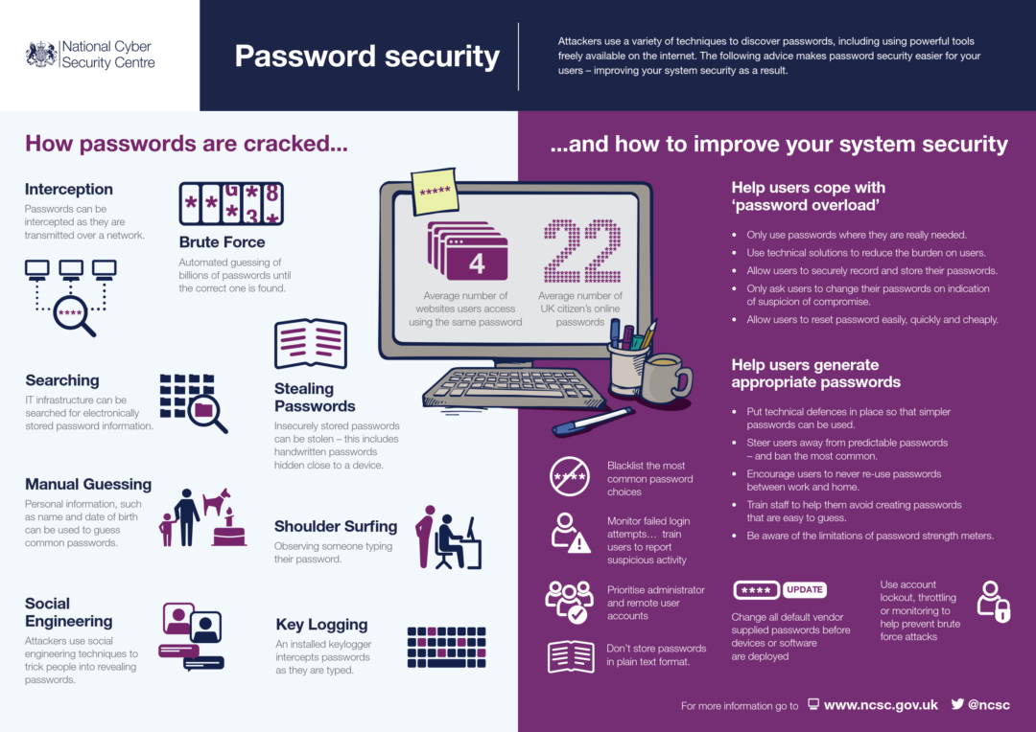

Slide 24
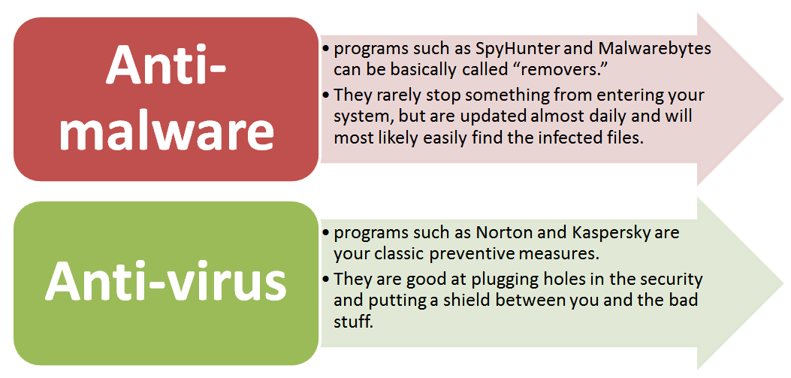
Keep it Updated

Slide 25
SAFE
NOT SAFE
Personal Information
Regularly update your security.
Set Strong password.
Keep Your Browsing Secret
Never click on emails from unknown sources
Backup your data
Close GPS
Email's scamming
telephone scamming
App scamming
Persons Social-Media scamming
Phishing
Ad-hoc Inform Other

Slide 26

More information
Keep your desktop clean
Keep your data in private cloud (MS, dropbox , google drive)
All your passwords in note physical prefer
Clean registry ,temp file (Ccleaner )
Save your data in disk D:/
Keep your system updated
Windows hack win + arrow

Slide 27


Slide 28
Reference
https://ironscales.com/blog/fake-login-pages-spoof-prominent-brands-phishing-attacks/
https://www.keepnetlabs.com/baiting/
https://www.kaspersky.com/resource-center/definitions/scareware
https://www.universnews.tn/eco-business/exclusif-la-biat-victime-aujourdhui-dune-mega-cyber-attaque/
https://www.nytimes.com/2016/06/23/technology/personaltech/mark-zuckerberg-covers-his-laptop-camera-you-should-consider-it-too.html
https://www.sonicwall.com/phishing-iq-test/

